Slide 1
CAR Champion Calibration Meeting CAR Review
Team “B”
Tovia Bat-Leah (CAR 143913123 Finding)
Jeff Lietz (CAR 143912892 Finding)
Kathy Lindstrom (CAR 143913435 Observation)
Jeff Lietz (CAR 143913094 Exemplary)

Slide 2
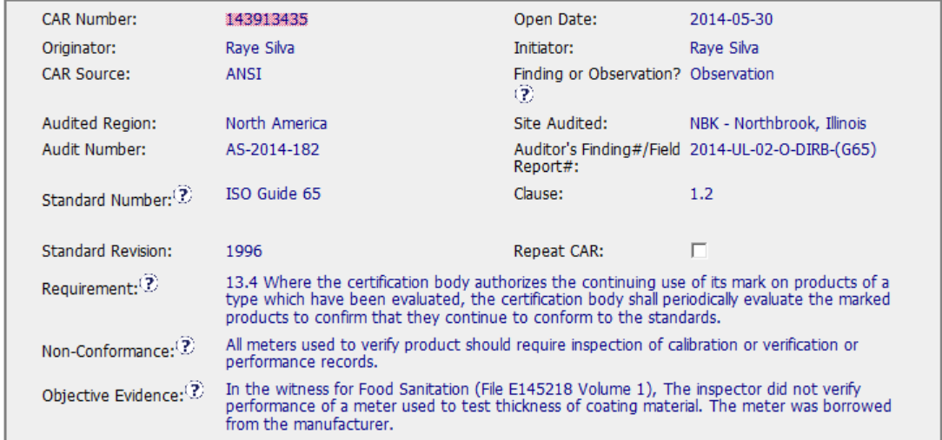
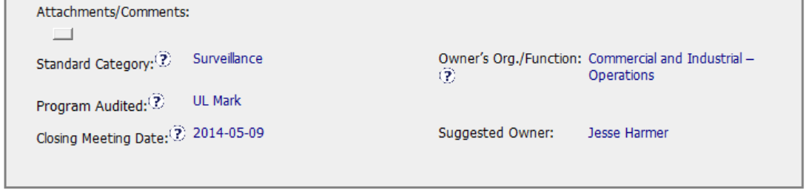
Evidence of Calibration was not available.

Slide 3
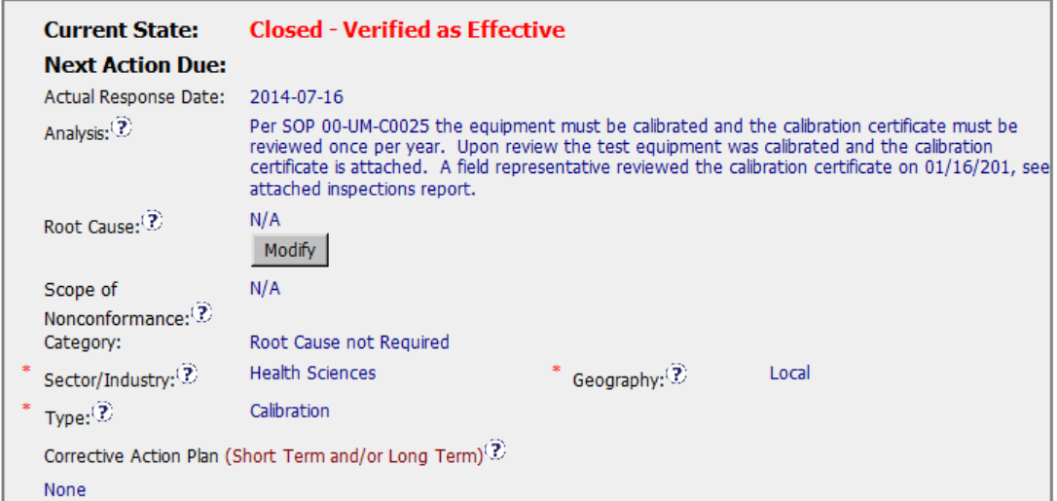
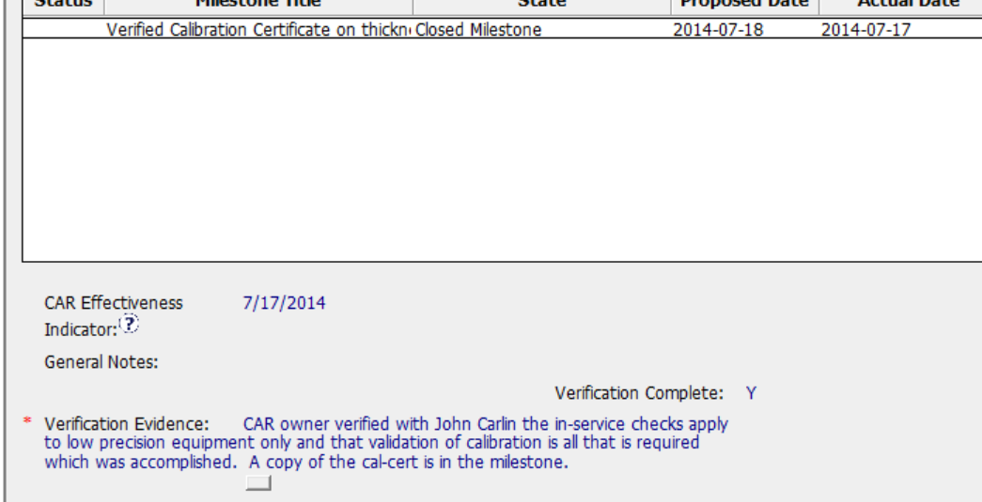
Good explanation
“None” made me second guess this. Would it be more clear to say, “Provide copy of Cal Cert as evidence that the meter was calibrated”?
Clear Verification evidence

Slide 4
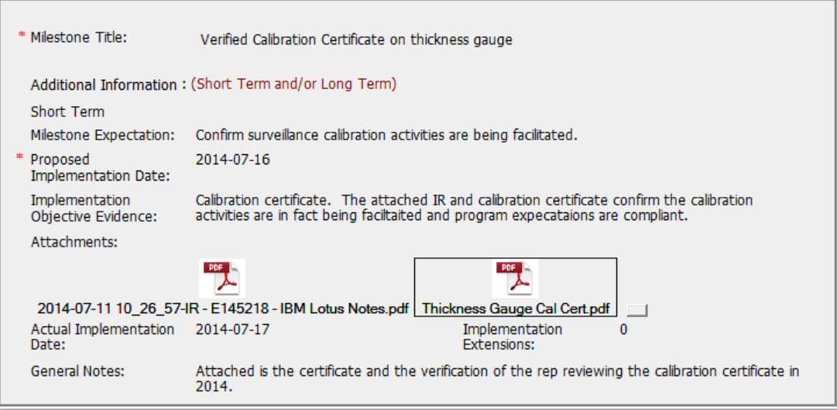
Milestone
Good objective evidence and
Explanation.
Car was verified immediately after accepting the evidence.

Slide 5
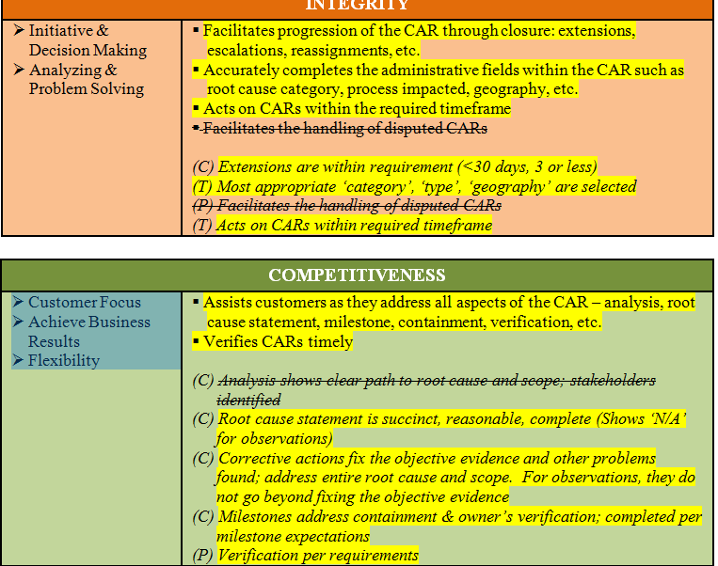
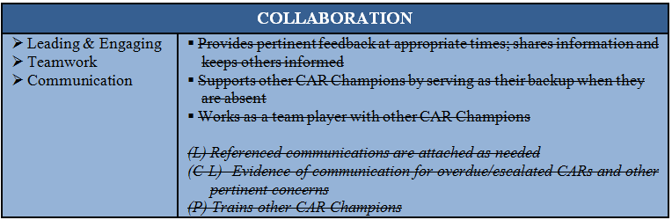
CBS Score Card
Straight forward
Observation

